Slide 1
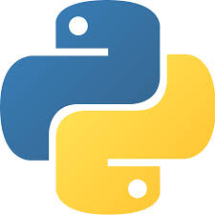
Welcome to Python!

Slide 2
Content
What Is Python?
Python Features
Python Applications
Downloading & Installing Python
Running Python

Slide 3
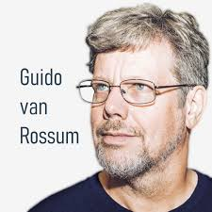
What Is Python?
Python is a general purpose, high-level, interpreted programming language.
Developed by Guido van Rossum in the
late 1980s at the National Research
Institute for Mathematics and Computer
Science in the Netherlands.
Python is one of the most popular and widely used programming language used for set of tasks including console based, GUI based, web programming and data analysis.
Fact: Python is named based on the comedy television show Monty Python's Flying Circus.

Slide 4
Python Features
Easy to Learn and Use
Python is easy to learn and use compared with other programming languages. It is developer-friendly and high level programming language.
Interpreted Language
Python is an interpreted language because no need of compilation. This makes debugging easy and thus suitable for beginners.
Cross-platform Language
Python can run equally on different platforms such as Windows, Linux, Unix and Macintosh etc. So, we can say that Python is a portable language.

Slide 5
Python Features Cont…
Free and Open Source
The Python interpreter is developed under an open-source license, making it free to install, use, and distribute.
Object-Oriented Language
Python supports object oriented language and concepts of classes and objects come into existence.
GUI Programming Support
Graphical user interfaces can be developed using Python.
Integrated
It can be easily integrated with languages like C, C++, and JAVA etc.

Slide 6
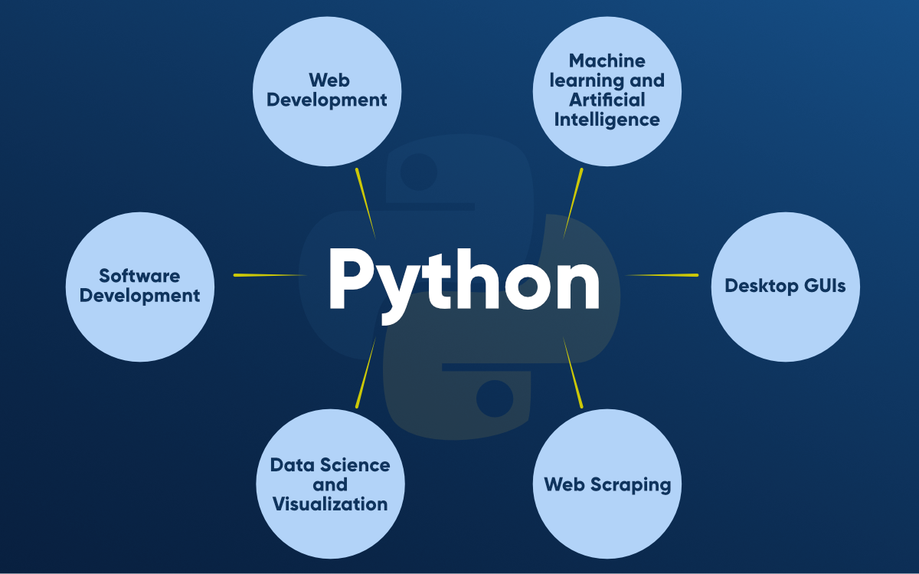
Python Applications

Slide 7
Downloading & Installing Python
To start programming with python, we have to install python software. There are two major Python versions, those are Python 2 and Python 3. Python 2 and 3 are quite different.
In this tutorial we are going to use Python 3, because it more semantically correct and supports newer features.
In this tutorial we are going to learn about installation of Python3 on Windows and Linux (Ubuntu).

Slide 8
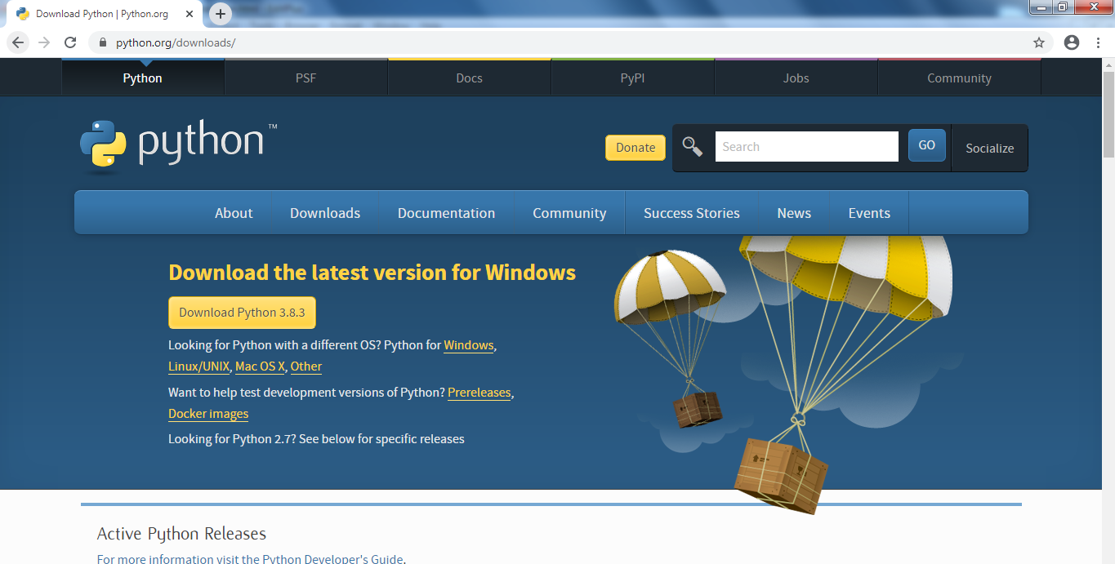
Downloading & Installing Python Cont…
Python3 installation procedure in Windows :
1. To install Python3 in windows, we have to download Python3 software pack from official website of Python Software Foundation. Go to https://www.python.org/

Slide 9
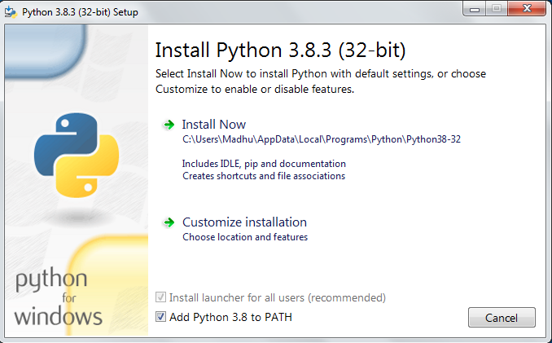
Downloading & Installing Python Cont…
2. Download the latest version of python(now latest version: python 3.8.3) for windows.
3. After the successful completion of download, we need to run python3.8.3.exe file.

Slide 10
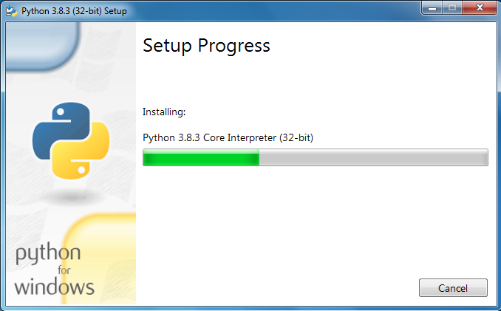
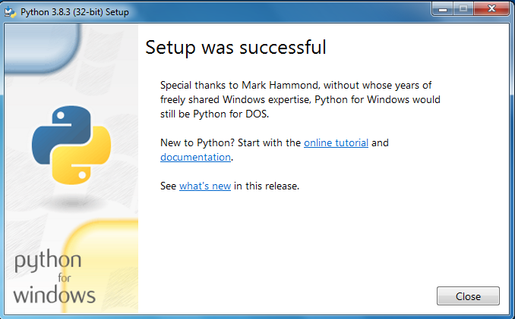
Downloading & Installing Python Cont…
First we need to check Add Python 3.8 to PATH, And then click on Install Now.
5. The Python setup will take 2 to 3 minutes of time, After successful installation the following window will be displayed

Slide 11
Running Python
After successful installation of python software we can able interpret or execute python script / program.
Python provides us the two ways to run a python script:
Using Interactive interpreter prompt
Using a script file
1. Using Interactive interpreter prompt:
Python provides us the feature to execute the python statement one by one at the interactive prompt.
It is preferable in the case where we are concerned about the output of each line of our python program.

Slide 12
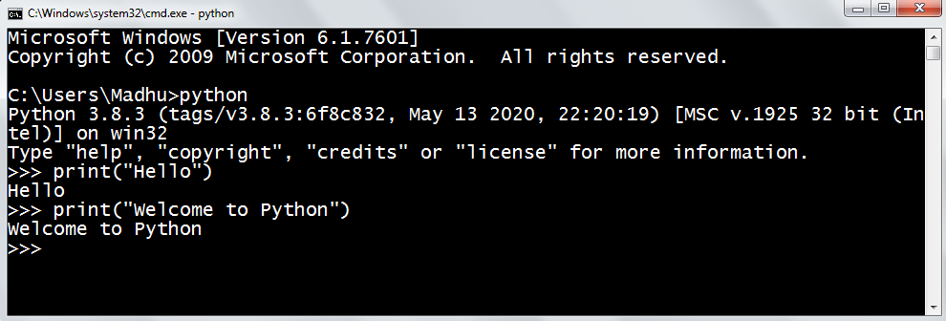
Running Python cont…
To open the interactive mode, open the terminal (or command prompt) and type python (python3 in case if you have python2 and python3 both installed on your system).
Through Command Prompt :

Slide 13
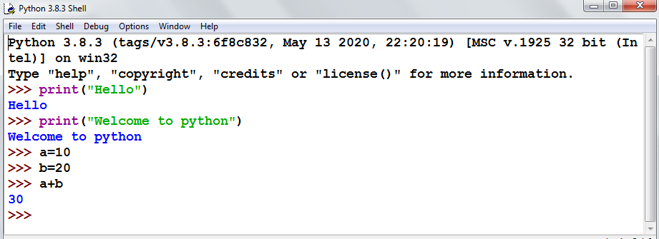
Running Python cont…
In windows, search for python IDLE in all programs and then click on python IDLE, then the python interpreter prompt will open.
Through python IDLE:

Slide 14
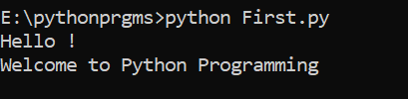
Running Python cont…
2. Using Script File :
Interpreter prompt is good to run the individual statements of the code. However if we want to execute multiple python statements at a time instead of executing one by one, then we can use script file.
We need to write our script into a file which can be executed later. For this purpose, open an editor like notepad, create a file named filename.py (python used .py extension) and write the python script in it.
Output:
Example: "First.py“
print("Hello !")
print("Welcome to Python Programming")

